Slide 1
VERBS
Verbs are doing words or actions.
You cannot create a sentence without a verb so knowing how they work is vital!
You must know the important questions to ask yourself as you create verbs in French.
We will look at the whole process in this presentation.

Slide 2
What are present tense verbs?
They describe what is happening now or happens on a general basis.
Examples in English are: I am running, I run.
The great thing about French is that you only need 1 verb for both of these verbs in English.
So French is easier than English!

Slide 3
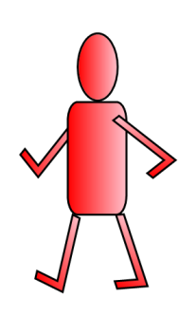
REGULAR VERBS: PRESENT TENSE Who is doing the verb? Which subject pronoun (person) do I need? What is the infinitive form of the verb? What do I need to do to the infinitive of the verb? What are the correct endings that need to be added?
AIMS:
To learn how to recognise regular present tense verbs.
To learn how to form regular present tense verbs.

Slide 4
Step 1: Choose the correct subject pronoun (the person doing the verb).
 |  | ENGLISH | FRENCH
1ST | SINGULAR | I | je/j’
2ND |  | YOU | tu
3RD |  | HE/SHE/WE | il/elle/on
1ST | PLURAL | WE | nous
2ND |  | YOU | vous
3RD |  | THEY | ils/elles

Slide 5
The infinitive of the verb is the one you find when you look it up in a dictionary.
You then have to apply your knowledge to the verb to make it correct.

Slide 6
VERBS ARE LIKE FLOWERS
They have a head and a stem.
REGARDER
FINIR
RÉPONDRE
HEAD >
STEM >

Slide 7
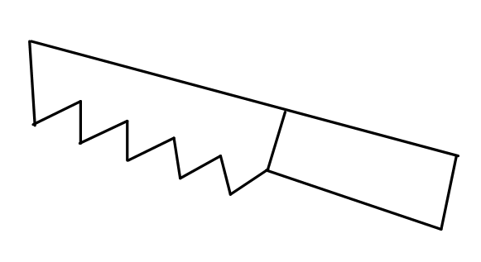
VERBS ARE LIKE FLOWERS
When you chop off the head, all you’re left with is a stem.

Slide 8
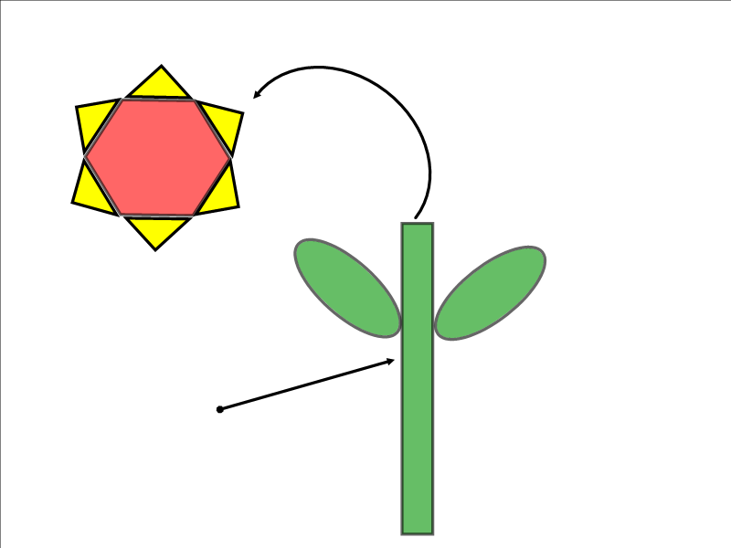
1. CHOP OFF THE HEAD
3. NOW ADD
THE CORRECT
ENDING TO MAKE
THE VERB
2. THEN YOU ARE LEFT
WITH THE STEM

Slide 9
Step 2: Find the infinitive of the verb and chop off the ending.
REGARDER
FINIR
RÉPONDRE
REGARD_
FIN_
RÉPOND_

Slide 10
Step 3: Add the correct ending for the person doing the verb.
SUBJECT PRONOUNS | -ER | -IR | -RE
je/j’ | E | IS | S
tu | ES | IS | S
il/elle/on | E | IT | _
nous | ONS | ISSONS | ONS
vous | EZ | ISSEZ | EZ
ils/elles | ENT | ISSENT | ENT

Slide 11
Now you will see a demonstration of how to apply this knowledge in some examples. When creating verbs yourself, you can either use a paper dictionary or an online dictionary like www.wordreference.com

Slide 12
Look at the following examples and conjugate verbs by following the patterns. Remember the 3 important steps. Pause the video to complete each task before carrying on.
Remember: Practice makes perfect.

Slide 13
ER
E.g. regarder to watch
Je regarde
Tu regardes
Il/Elle regarde
Nous regardons
Vous regardez
Ils/Elles regardent
Copy down this verb and then conjugate 3 of these verbs following the same pattern as regarder:
Aimer – to like (J’ in the “I” form)
Jouer – to play
Travailler – to work
Marcher – to walk
Dessiner – to draw
Détester – to hate
Copier – to copy
Porter – to wear
Écouter – to listen (J’ in the “I” form)
Éviter – to avoid (J’ in the “I” form)
Voyager – to travel *
Manger – to eat *
* Verbs ending in –gER keep the “e” in the nous form to maintain the sound.
NOTICE: The –ER form of the verb (the infinitive) is the one you find when you look up a verb in the dictionary.

Slide 14
IR
E.g. finir to finish
Je finis
Tu finis
Il/Elle finit
Nous finissons
Vous finissez
Ils/Elles finissent
Copy down this verb and then conjugate 2 of these verbs following the same pattern as finir:
choisir – to choose
remplir – to fill
établir - to establish (J’ in the “I” form) grossir - to gain weight, get fat maigrir - to lose weight, get thin nourrir - to feed, nourish
bâtir - to build
punir – to punish
réussir – to succeed
Notice how the endings are the same in the plural (nous, vous, ils/elles) as –ER verbs,
with the letters –iss before them.
NOTICE: The –IR form of the verb (the infinitive) is the one you find when you look up a verb in the dictionary.

Slide 15
RE
E.g. répondre to answer/respond
Je réponds
Tu réponds
Il/Elle répond_
Nous répondons
Vous répondez
Ils/Elles répondent
Copy down this verb and then conjugate 2 of these verbs following the same pattern as répondre:
entendre - to hear (J’ in the “I” form) perdre - to lose vendre - to sell
prétendre - to claim rendre - to give back, return répandre - to spread, scatter pendre - to hang, suspend
Notice how the endings are the same in the plural (nous, vous, ils/elles) as –ER verbs.
NOTICE: The –RE form of the verb (the infinitive) is the one you find when you look up a verb in the dictionary.

Slide 16
Match up the subject pronouns with the correct translation. Pause the recording, complete the activity and then mark your work. If you get it wrong, correct your answer so you learn from your mistake.
Je/J’
Tu
Il
Elle
Nous
Vous
Ils
Elles
She
They (f)
He
We
I
You (singular)
They (m)
You (plural)

Slide 17
Look at the endings of the following verbs and decide on the correct subject pronouns. Use the aide-mémoire on the right or the verbs you have just copied down to help you. Pause the recording, complete the activity and then mark your work. If you get it wrong, correct your answer so you learn from your mistake.
TU
NOUS
VOUS
ILS/ELLES
IL/ELLE
TU
IL/ELLE
NOUS
________ penses
________ descendons
________ rangez
________ rougissent
________ réflechit
________ sautes
________ fond
________ bachotons
AIDE-MÉMOIRE
JE’J TU IL/ELLE NOUS VOUS ILS/ELLES | I YOU (s) HE/SHE WE YOU (p) THEY

Slide 18
Look up the following verbs in a dictionary. You will see the words ending in ER, IR or RE. That will tell you which ending to add. Use the aide-mémoire on the right to help you. Pause the recording, complete the activity and then mark your work. If you get it wrong, correct your answer so you learn from your mistake.
Je coup___
Il réflech___
Nous pens___
Elles mang___
Vous chois___
Tu lav___
Elle roug___
Je descend___
E
IT
ONS
ENT
ISSEZ
ES
IT
S
AIDE-MÉMOIRE
JE’J TU IL/ELLE NOUS VOUS ILS/ELLES | ER -e -es -e -ons -ez -ent | IR -is -is -it -issons -issez -issez | RE -s -s - -ons -ez -ent

Slide 19
Translate the following verbs into English. Remember: work out the subject pronoun then the verb. Pause the recording, complete the activity and then mark your work. If you get it wrong, correct your answer so you learn from your mistake.
Je déteste
Nous choisissons
Elle commence
Tu sautes
Elles glissent
I hate
We choose
She starts
You (s) jump
They slide

Slide 20
AIDE-MÉMOIRE: FRENCH PRESENT TENSE Subject pronoun + (space) + Stem* + Ending
ENGLISH | FRENCH
I | Je/J’
You | Tu
He/She/We | Il/Elle/On
We | Nous
You | Vous
They | Ils/Elles
ER | IR | RE
E | IS | S
ES | IS | S
E | IT
ONS | ISSONS | ONS
EZ | ISSEZ | EZ
ENT | ISSENT | ENT
Je regarde = I watch
Je finis = I finish
Je réponds = I answer
*Stem = The infinitive (the one you find when you
look in a dictionary) minus the last 2 letters.
.

Slide 21
Now translate the following verbs into English. Remember: Decide on the correct subject pronoun, find the infinitive of the verb, chop the last 2 letters off and then add the appropriate ending for that person. Pause the recording, complete the activity and then mark your work. If you get it wrong, correct your answer so you learn from your mistake.
I sell
He wastes
We melt
They (m) jump
I study
Je vends
Il gaspille
Nous fondons
Ils sautent
J’étudie

Slide 22
There are some vitally important verbs that don’t follow the same patterns. These are called irregular verbs. You just have to learn them and then look them up if you are not sure when you are using them!
Avoir – to have | Être – to be | Aller – to go | Faire – to do/make
J’ai | Je suis | Je vais | Je fais
Tu as | Tu es | Tu vas | Tu fais
Il/Elle a | Il/Elle est | Il/Elle va | Il/Elle fait
Nous avons | Nous sommes | Nous allons | Nous faisons
Vous avez | Vous êtes | Vous allez | Vous faites
Ils/Elles ont | Ils/Elles sont | Ils/Elles vont | Ils/Elles font

Slide 23
REGULAR VERBS: PRESENT TENSE Who is doing the verb? Which subject pronoun (person) do I need? What is the infinitive form of the verb? What do I need to do to the infinitive of the verb? What are the correct endings that need to be added?
AIMS:
To learn how to recognise regular present tense verbs.
To learn how to form regular present tense verbs.

